Slide 1
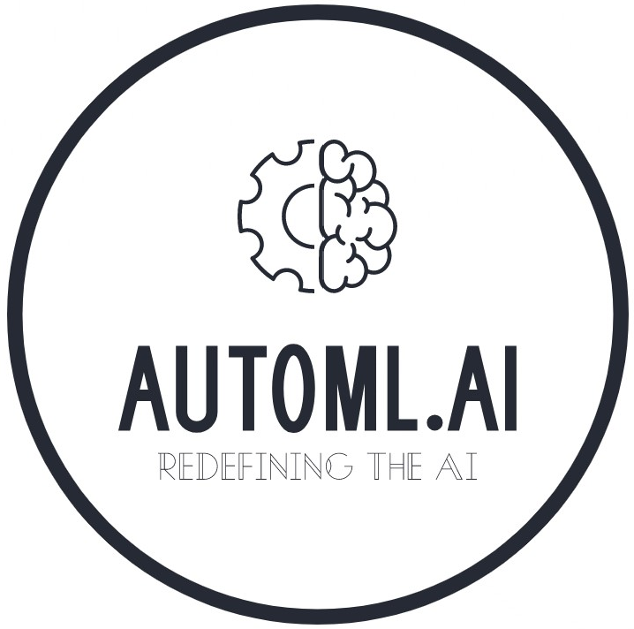

Slide 2
Table of Contents
Problem Statement
Problem, Why solve it?, Approach and Solution
Automl
ABCD, Objectives, Methods and Skills
Market
Domain based and future projection
Conclusion
Overview, Skills, Experience and future work

Slide 3
Problem Statement
Problem
Approach
ML model is build with a manual procedure
AutoML approach to automate the model building
Why solve it?
Solution
To consume less time and increase growth
Deploy to make the process seamless

Slide 4
Automl

Slide 5
ABCD
Automate
Build
Code
Deploy
Automate the entire machine learning pipeline
Build a solid machine leaning model (pkl or sav files)
Approaches Low-code platform to prevent time consumption
Deployed using GitHub and Streamlit framework

Slide 6
Objectives
2
4
Affordable solution for the users and industries
Click button execution with no keyboard interference
Low-code approach which generates the model
Robust and efficient WebApp approach
1
3

Slide 7
Methods & Skills
Sklearn library for Machine Learning task
Pycaret to execute Machine Learning models faster
Plotly for Graphica Visualization purposes
GitHub for deploying and maintaining the algorithm
Pandas for Exploratory Data Analysis
StreamLit for designing and publishing the WebApp

Slide 8
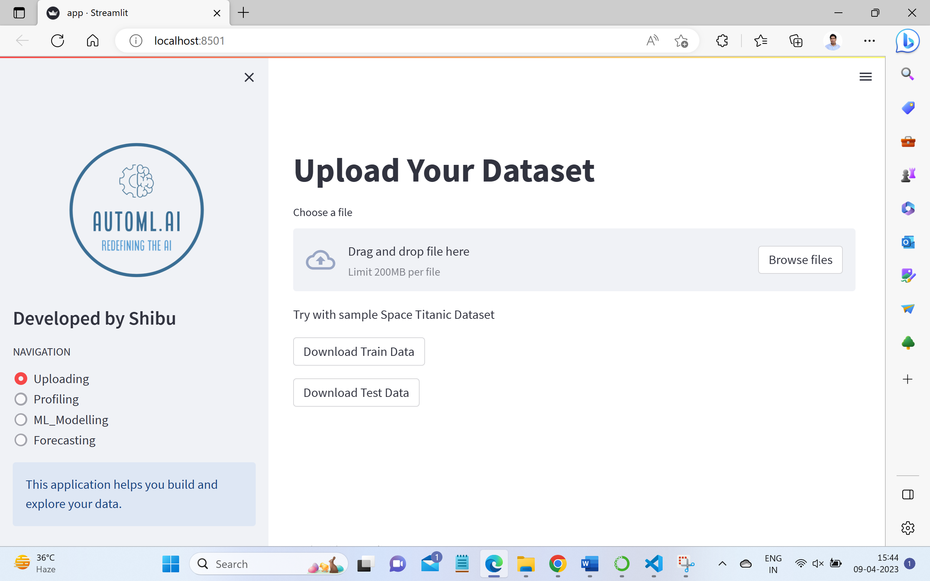

Slide 9
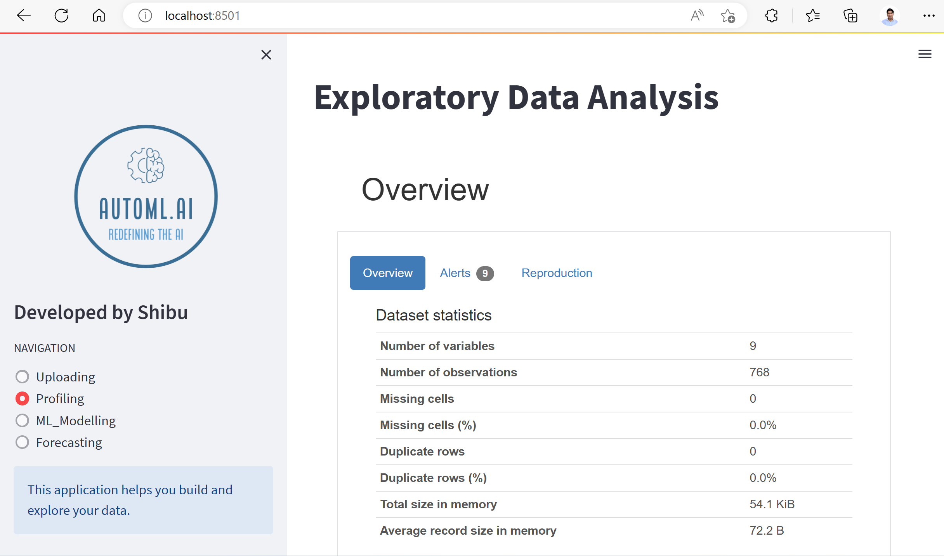

Slide 10
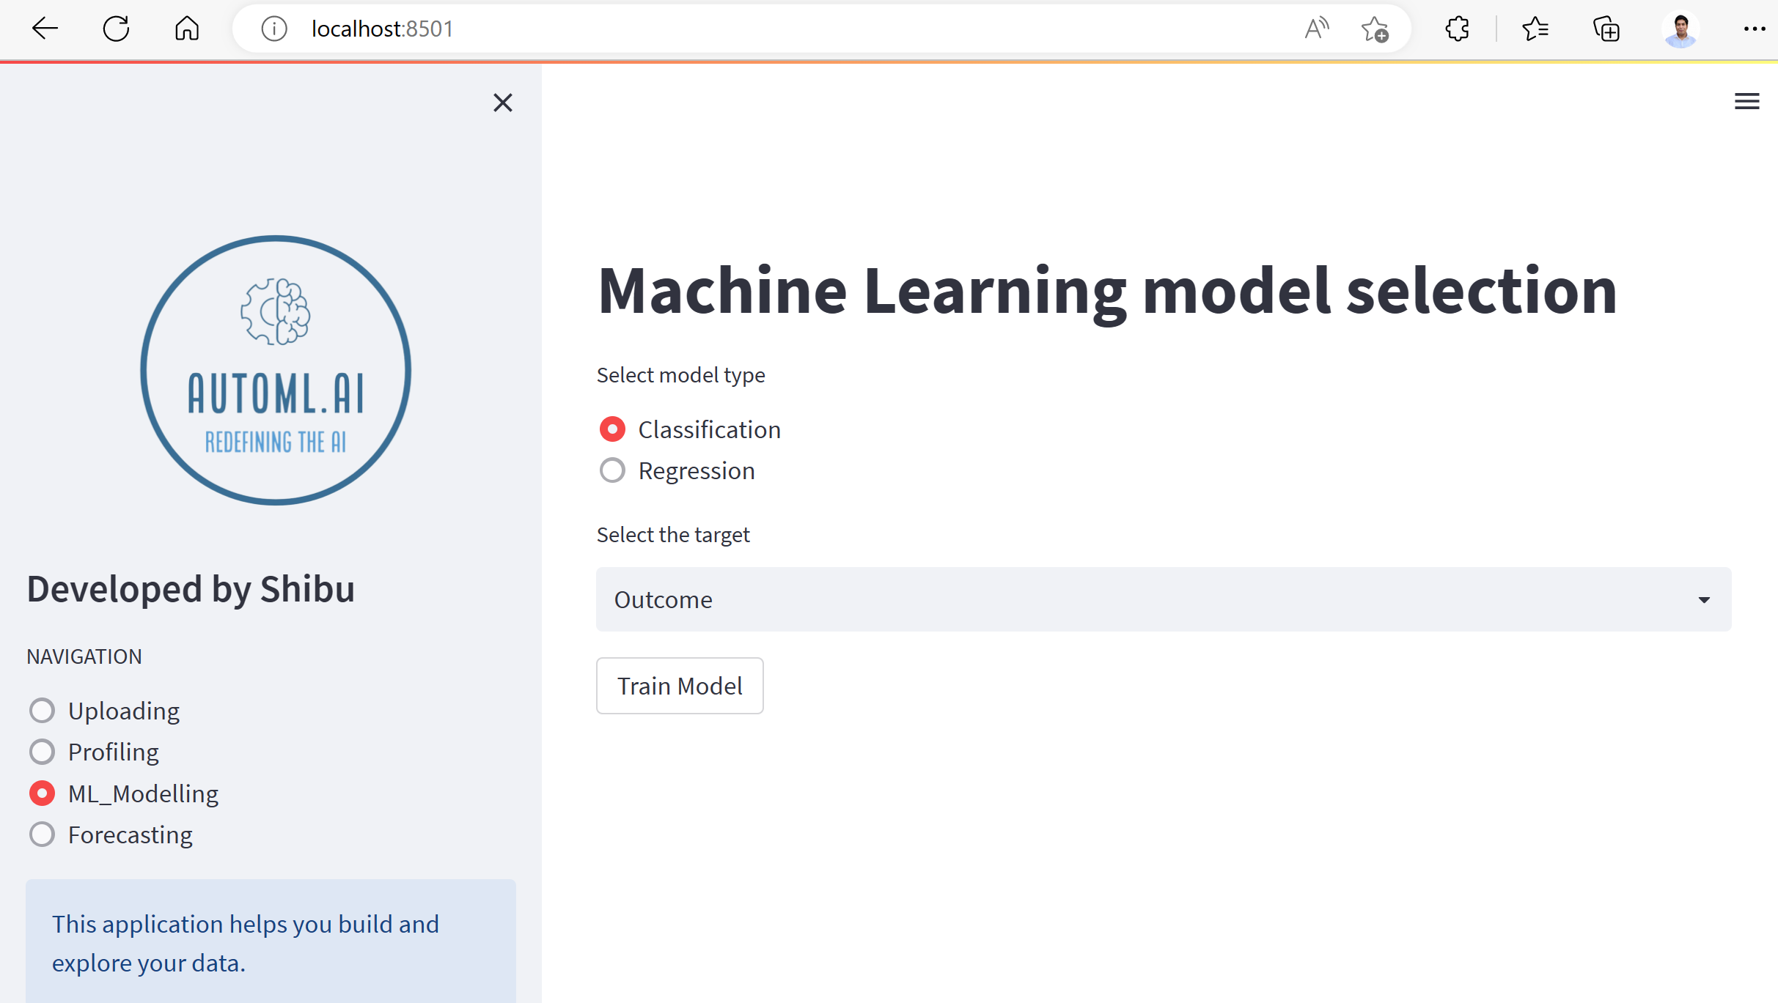

Slide 11
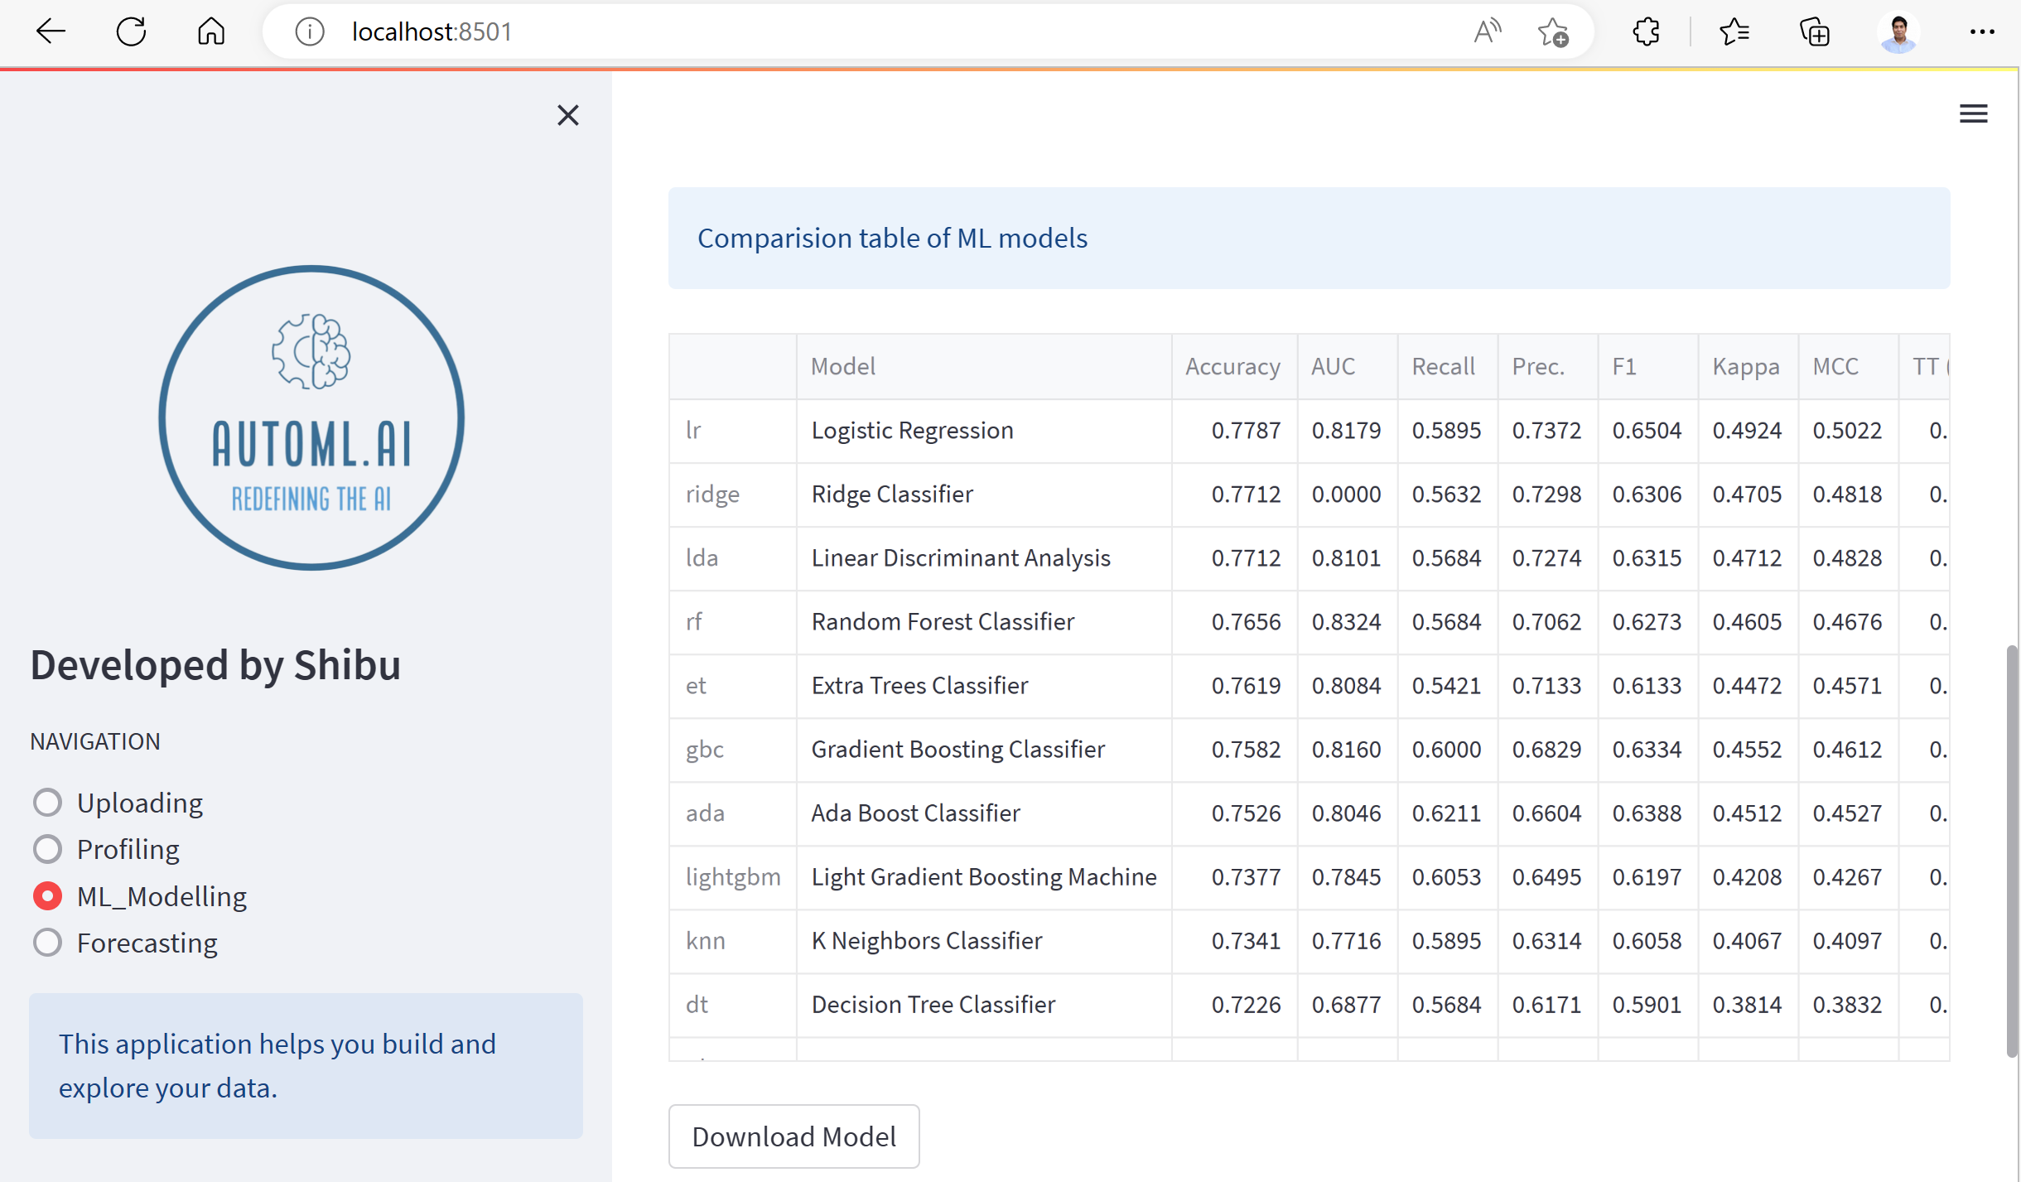

Slide 12
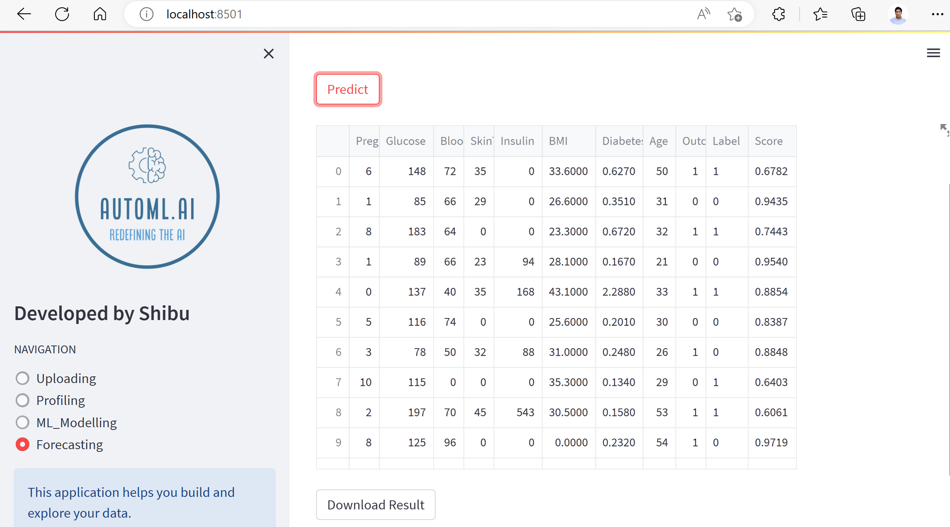

Slide 13
Market

Slide 14
Domain based
50%
30%
1st Rank
02
2nd Rank
Sales & marketing management held 50 % revenue share in Q1 2023
Fraud Detection held 45 % revenue share in Q1 2023
$ 700 million
01
10%
20%
4th Rank
03
3rd Rank
Other domains like Oil, Government, Manufacturing, etc
Mediacal domain held 25 % revenue share in Q1 2023
04

Slide 15
Future Projection
Europe
Leading market in terms of finance industry
APAC
MAE
Fastest growing market by region (2020-2030)
Emerging sector by region
North America
LATAM
Largest market by region (2023)
Least growing by region

Slide 16
Conclusion
Overview
Experience
Automl is an emerging concept and has potential of solving ML tasks
Able to understand StreamLit and developing new things into the existing modules
Skills
Future Work
The use of industry oriented libraries gave me the exposure of entire ML pipeline
To implement Deep Learning and create an ETL for Business Intelligence

Slide 17
Thank you !!
Presented by
Shibu Mohapatra
MSC AI
Roll no: 02
Guide
Prof. Asmita Marathe
Project Details
Automl.ai
Machine Learning based
Contact
Mobile: +91 8208213211
Email: mohapatrashibu@gmail.com

